Slide 1

Analyzing Amazon Sales Data Report

Slide 2


Introduction
Objective
The primary objective of this analysis is to dissect historical sales data, unravel hidden patterns, and provide actionable insights to drive strategic decisions By leveraging advanced analytical techniques,we aim to empower businesses with the knowledge needed to optimize sales strategies and maximize profitability.
﻿
Importance of Sales Trend Analysis
Sales trend analysis serves as a compass for businesses, guiding them through the complexities of the market. By examining historical sales data, businesses can identify emerging trends, anticipate customer preferences, and adapt their strategies accordingly. Whether it's identifying seasonal fluctuations or detecting changing consumer behavior, sales trend analysis equips businesses with the foresight needed to stay ahead of the curve.

Slide 3
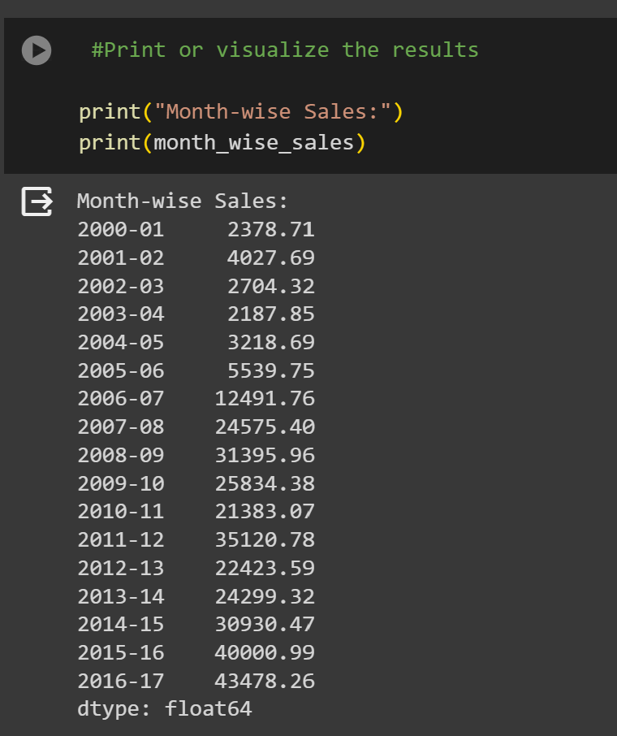
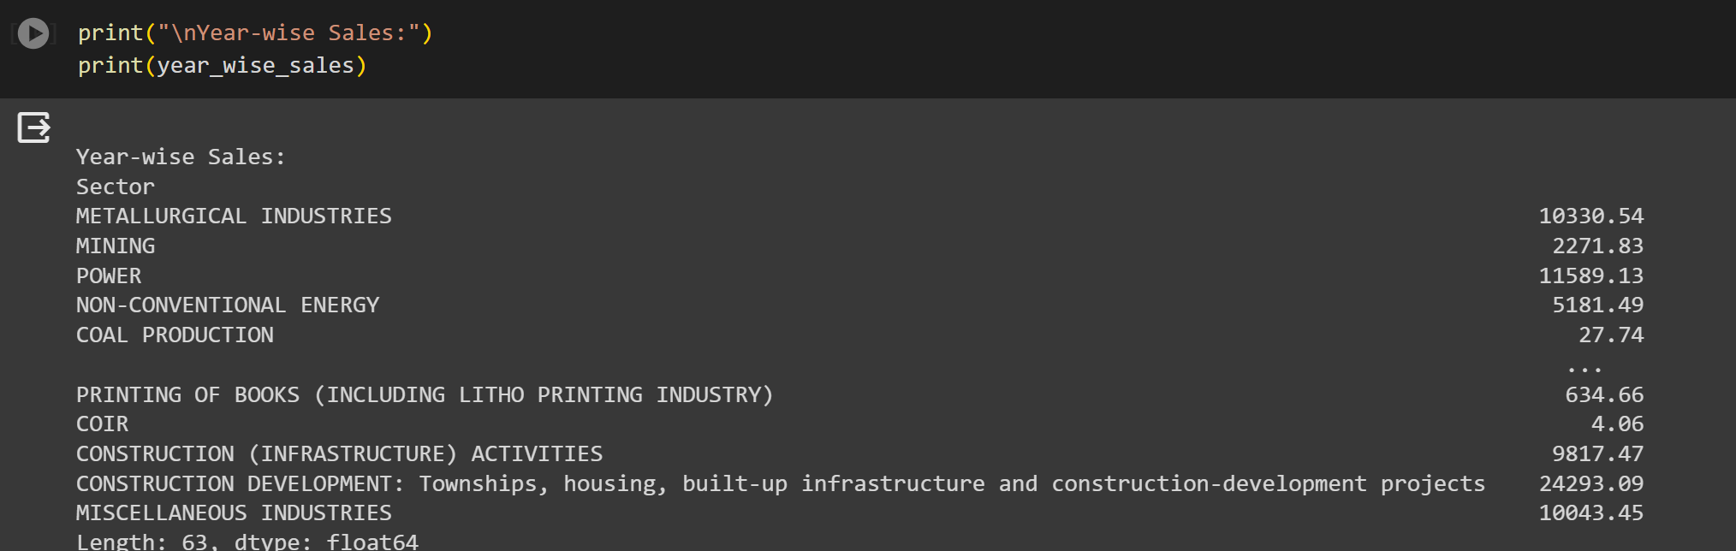
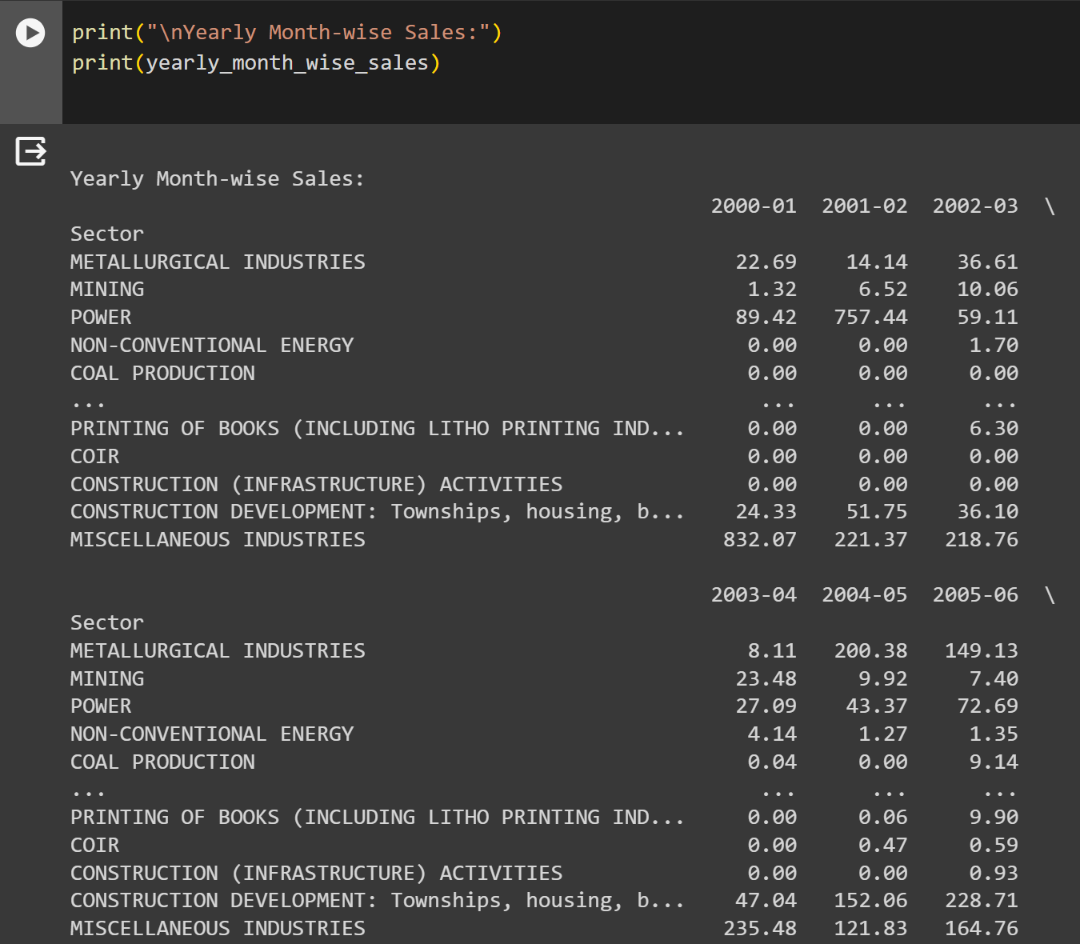
Sales Trends Analysis in Python
Month-wise Trends
Analyzed sales data on a month-by-month basis to identify patterns and trends.
Identified peak sales months and months with low sales.
Year-wise Trends
Examined sales data over multiple years to identify long-term trends.
Identified growth or decline in sales over time.
Yearly-Monthly Trends
Analyzed sales data for each month of the year to identify seasonal trends.
Identified months with high sales and months with low sales.
Insights and Implications
The analysis revealed that sales tend to peak during the holiday season, indicating the importance of targeted marketing campaigns during this time.
The analysis also showed a decline in sales during certain months, suggesting the need for promotional activities to boost sales during these periods.
These insights can inform decision-making in sales and marketing strategies, helping to optimize resource allocation and drive revenue growth.

Slide 4
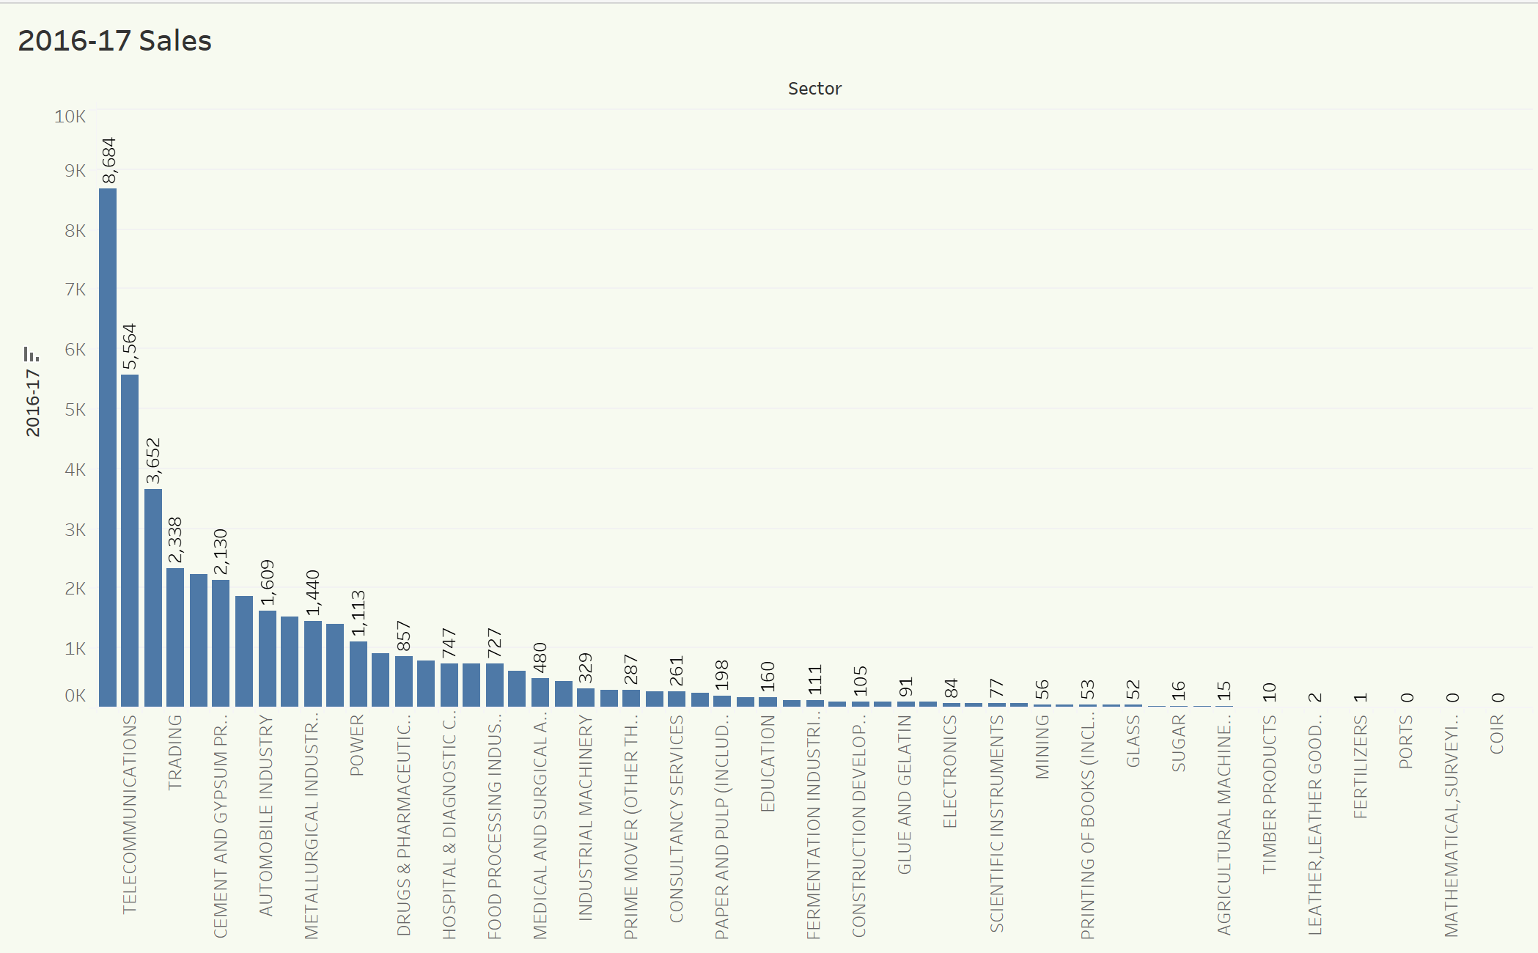
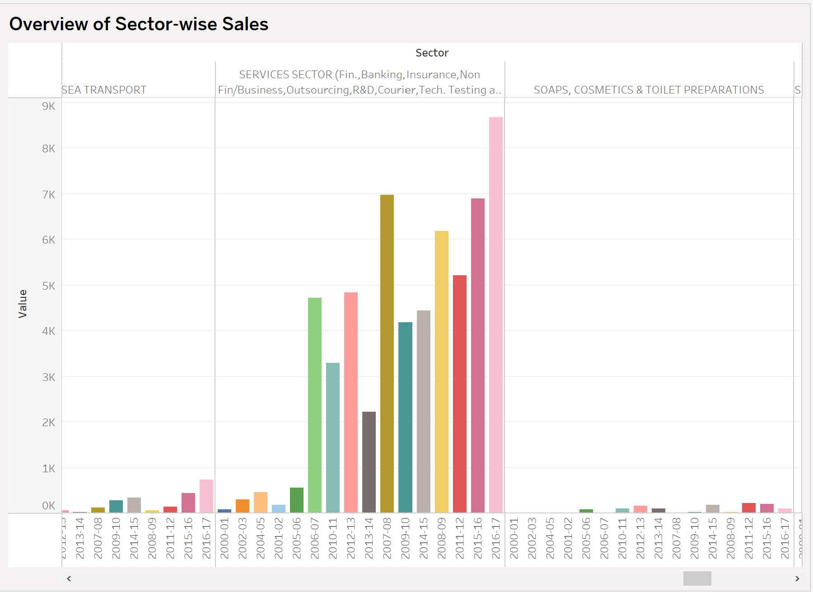
Data Visualization
Importance of Data Visualization
Data visualization plays a crucial role in understanding complex data patterns.
Visual representations such as bar charts and line plots make it easier to identify trends and patterns in sales data.
Visualizations help in making data-driven decisions by providing clear insights into sales performance.

Slide 5
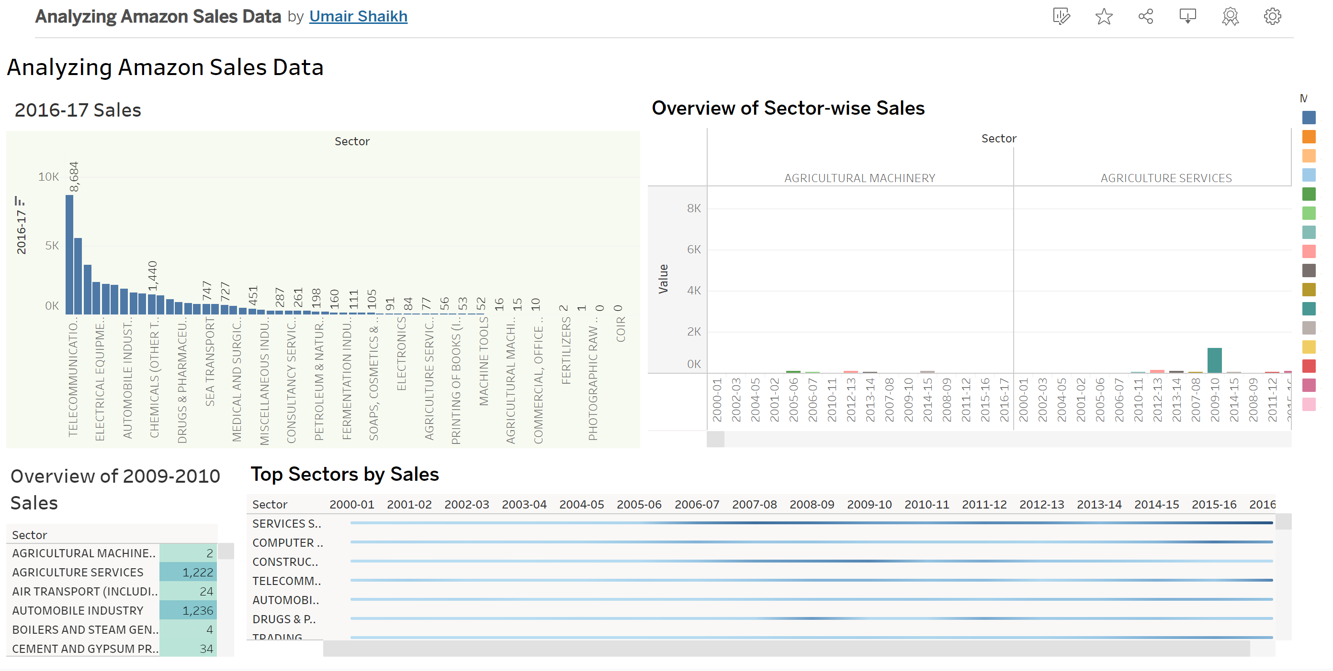
Dashboard

Slide 6

Thank You
Thank you for your attention and interest in our sales trends analysis report.
If you have any further inquiries or would like to collaborate with us, please feel free to contact us at:
Email: umair.shaikh0214@gmail.com

